Slide 1
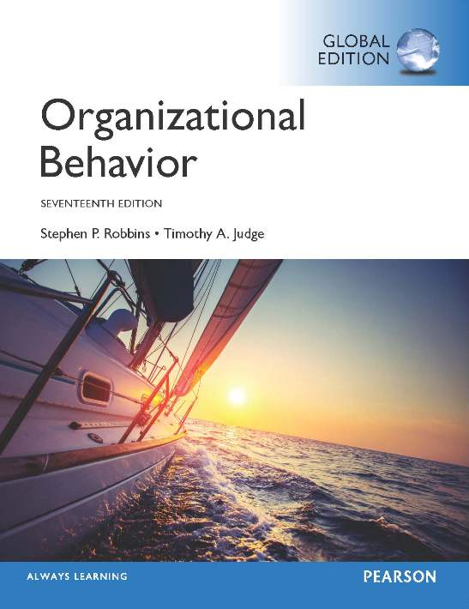
Notes:
Welcome to this Organizational Behavior course that uses the 17th edition of the textbook, Organizational Behavior by Robbins and Judge. This is considered among the most widely used OB textbooks in the world. Robbins and Judge are recognized as definitive aggregators of OB concepts, applications, and practices. The course and this book will provide you with a resource that will benefit you throughout your degree program and your professional life.

Slide 2
4
Emotions
and
Moods
Notes:
Chapter 4: Emotions and Moods

Slide 3
Learning Objectives
Differentiate between emotions and moods.
Identify the sources of emotions and moods.
Show the impact emotional labor has on employees.
Describe affective events theory.
Describe emotional intelligence.
Identify strategies for emotion regulation.
Apply concepts about emotions and moods to specific OB issues.
Notes:
After studying this chapter, you should be able to:
Differentiate between emotions and moods.
Identify the sources of emotions and moods.
Show the impact emotional labor has on employees.
Describe affective events theory.
Describe emotional intelligence.
Identify strategies for emotion regulation.
Apply concepts about emotions and moods to specific OB issues.
We will discuss each of these objectives in some detail.

Slide 4
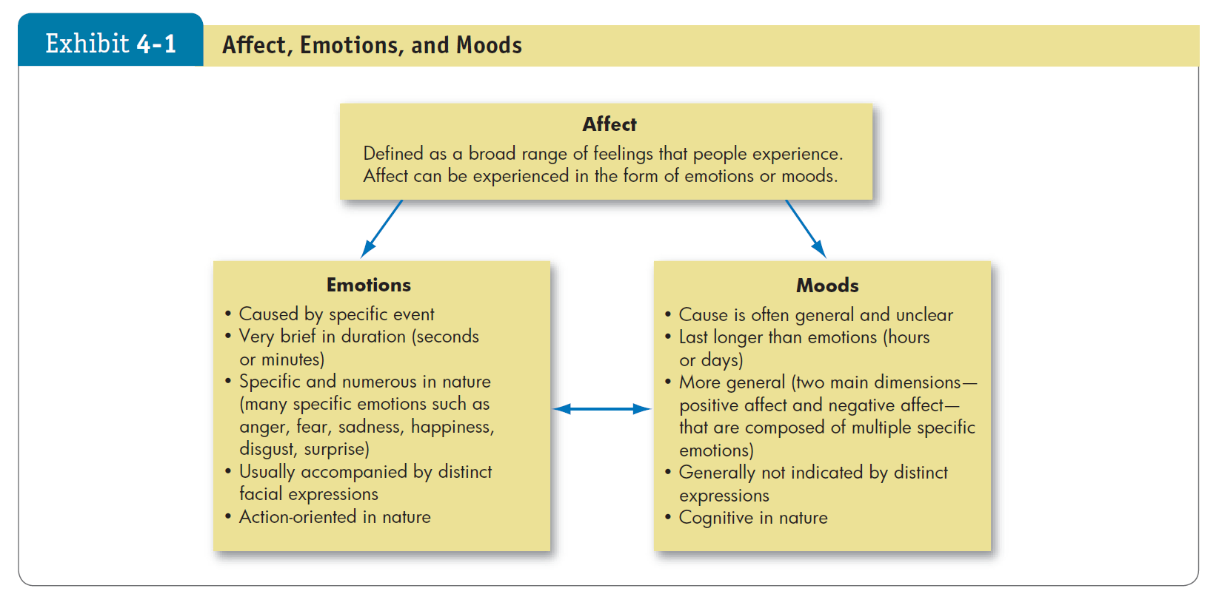

Differentiate Between Emotions and Moods
LO 1
Affect is a generic term that covers a broad range of feelings people experience. This includes both emotions and moods. Emotions are intense feelings that are directed at someone or something. Moods are the feelings that tend to be less intense than emotions and that lack a contextual stimulus.
Notes:
Three terms that are closely intertwined: affect, emotion, and moods.
Affect is a generic term that covers a broad range of feelings people experience. This includes both emotions and moods. Emotions are intense feelings that are directed at someone or something. Moods are the feelings that tend to be less intense than emotions and that lack a contextual stimulus.

Slide 5



Differentiate Between Emotions and Moods
LO 1
Six essentially universal emotions
Anger
Fear
Sadness
Happiness
Disgust
Surprise
Notes:
Though not all psychologists agree, there do seem to be six basic emotions that emerge in studies: anger, fear, sadness, happiness, disgust, and surprise. All other emotions fall under these six categories. Sometimes as many as twelve emotions are identified.

Slide 6






Differentiate Between Emotions and Moods
LO 1
Moral Emotions
Moral emotions: emotions that have moral implications because of our instant judgement of the situation that evokes them.
Our responses to moral emotions differ from our responses to other emotions.
Moral emotions are learned, usually in childhood.
Because morality is a construct that differs between cultures, so do moral emotions.
Notes:
Researchers have been studying what are called moral emotions; that is, emotions that have moral implications because of our instant judgement of the situation that evokes them. Interestingly, research indicates that our responses to moral emotions differ from our responses to other emotions.
Moral emotions are learned, usually in childhood, and thus, they are not universal like innate emotions.
Because morality is a construct that differs between cultures, so do moral emotions. Therefore, we need to be aware of the moral aspects of situations that trigger our emotions and make certain we understand the context before we act, especially in the workplace.

Slide 7
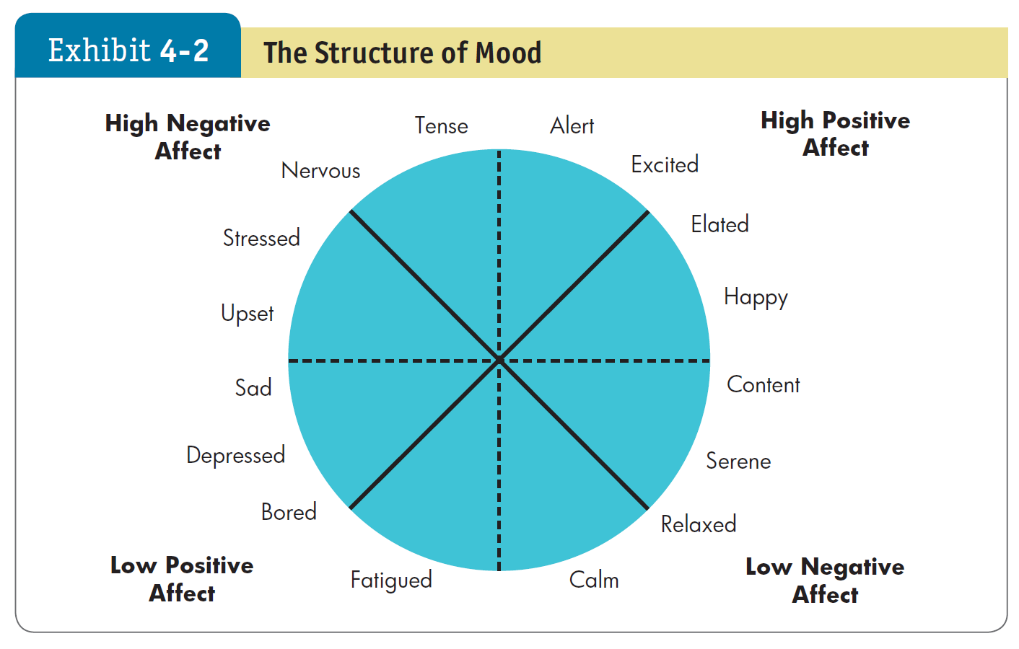
Differentiate Between Emotions and Moods
LO 1
Notes:
Our basic moods carry positive and negative affects, and they cannot be neutral. Emotions are grouped into general mood states as shown in Exhibit 4-2. These states impact how employees perceive reality; thereby, the moods can impact the work of employees.
At zero input, most people experience a mildly positive mood. This is referred to as positivity offset.
People in most cultures experience certain positive and negative emotions, but the frequency and tendency varies somewhat.

Slide 8



The Structure of Moods
positive affect: A mood dimension that consists of specific positive emotions such as excitement, enthusiasm, and elation at the high end (high positive affect)
Negative affect: A mood dimension that consists of emotions such as nervousness, stress, and anxiety at the high end (high negative affect)
positivity offset: at zero input (when nothing in particular is going on), most individuals experience a mildly positive mood
Notes:
While we rarely experience both positive and negative affect at the same time, over time people do differ in how much they experience each. Some people (we might call them emotional or intense) may experience quite a bit of high positive and high negative affect over, say, a week’s time. Others (we might call them unemotional or phlegmatic) experience little of either. And still others may experience one much more predominately than the other.

Slide 9
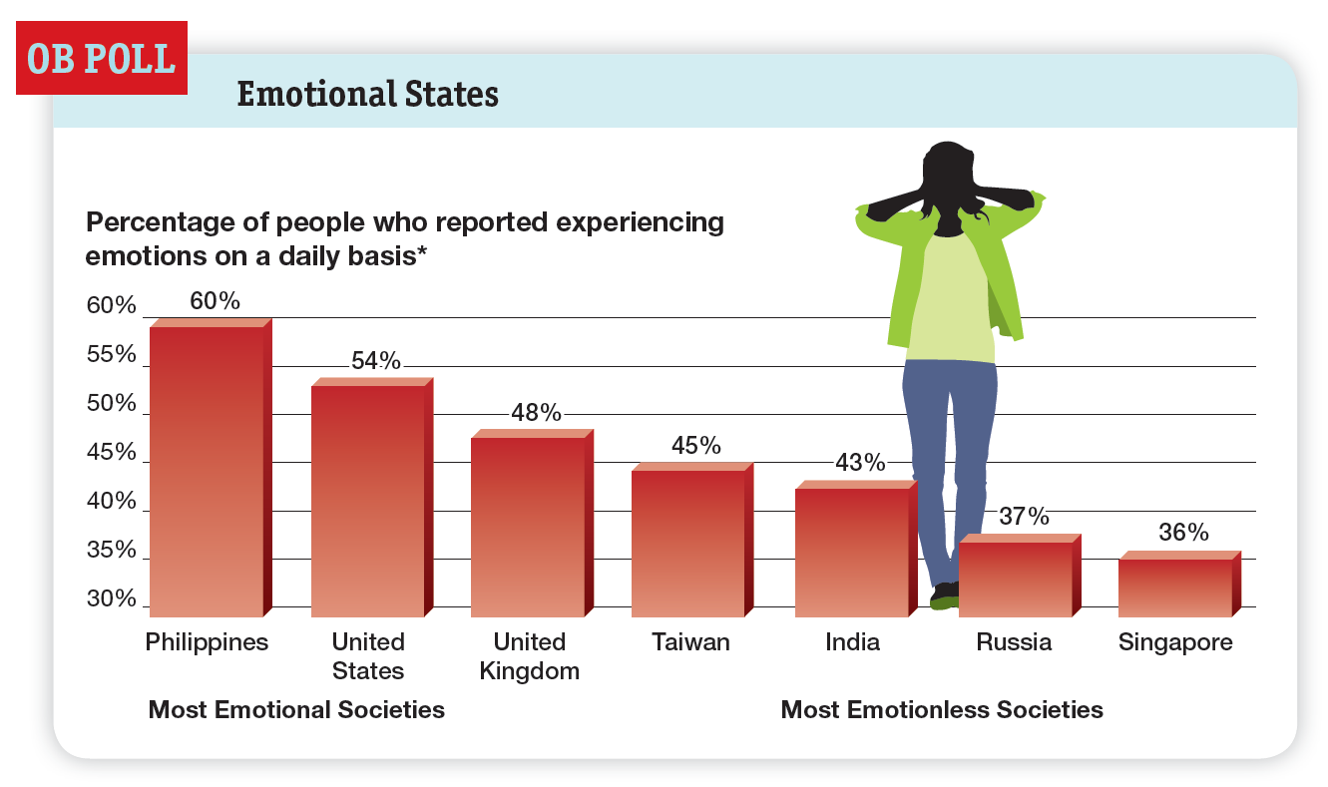

Differentiate Between Emotions and Moods
LO 1
Notes:
As if it weren’t complex enough to consider the many distinct emotions and moods a person might identify, the reality is that we all experience moods and emotions differently.
For most people, positive moods are somewhat more common than negative moods. Indeed, research finds a positivity offset, meaning that at zero input (when nothing in particular is going on), most individuals experience a mildly positive mood.
Does the degree to which people experience positive and negative emotions vary across cultures? Yes (see the OB Poll).
People in most cultures appear to experience certain positive and negative emotions, and people interpret them in much the same way worldwide.
However, an individual’s experience of emotions appears to be culturally shaped.

Slide 10


Differentiate Between Emotions and Moods
The degree to which people experience positive and negative emotions vary across cultures
The reason is not that people of different cultures are inherently different
We all view negative emotions such as hate, terror, and rage as dangerous and destructive, and we desire positive emotions such as joy, love, and happiness
Collectivist vs. Individualist countries
Notes:
The reason is not that people of different cultures are inherently different: People in most cultures appear to experience certain positive and negative emotions, and people interpret them in much the same way worldwide. However, an individual’s experience of emotions appears to be culturally shaped.
We all view negative emotions such as hate, terror, and rage as dangerous and destructive, and we desire positive emotions such as joy, love, and happiness. However, an individual’s experience of emotions appears to be culturally shaped. (Some cultures embrace negative emotions, such as Japan and Russia, while others emphasize positive emotions and expressions, such as Mexico and Brazil)

Slide 11
LO 1
Differentiate Between Emotions and Moods
Decision Making
Thinking
Feeling
Notes:
Do emotions make us irrational? There are some who think that emotions are linked to irrationality and that expressing emotions in public may be damaging to your career or status. However, research has shown that emotions are necessary for rational thinking. They help us make better decisions and help us understand the world around us. If we are going to make decisions, we need to incorporate both thinking and feeling.

Slide 12

LO 1
Differentiate Between Emotions and Moods
البحث عن المشاعر الأخلاقية يشكك في الاعتقاد السابق بأن اتخاذ القرار العاطفي يعتمد على العمليات الإدراكية عالية المستوى
Do emotions make us ethical?
Research on moral emotions questions the previous belief that emotional decision making is based on higher-level cognitive processes.
Our beliefs are shaped by our groups, resulting in an unconscious feeling that our shared emotions are “right.”
Notes:
A growing body of research has begun to examine the relationship between emotions and moral attitudes.
Examples of moral emotions include sympathy for the suffering of others, guilt about our own immoral behavior, anger about injustice done to others, contempt for those who behave unethically, and disgust at violations of moral norms. Numerous studies suggest that these reactions are largely based on feelings rather than on cold cognition.
Our beliefs are actually shaped by our groups, which influence our perceptions of others, resulting in unconscious responses and a feeling that shared emotions are “right.” Unfortunately, this feeling allows us sometimes to justify purely emotional reactions as “ethical.” In work and in life, our moral judgments therefore have more to do with emotions than with cognitions, yet we tend to think the opposite, especially when those judgments are shared by fellow members of our in-group.
We can conclude that people who are behaving ethically are at least partially making decisions based on their emotions and feelings, and this emotional reaction will often be a good thing.

Slide 13


Identify the Sources of Emotions and Moods
LO 2
Personality
Moods and emotions have a trait component.
Affect intensity: how strongly people experience their emotions.
Time of Day
There is a common pattern for all of us.
Happier in the midpoint of the daily awake period.
Day of the Week
Happier toward the end of the week.
Notes:
There are many things that impact our mood and emotions. Personality is a key component and will definitely impact the intensity of the emotions we feel. The day and time of the week is a common pattern for all of us as well.
Exhibit 4-3 in your text shows the results of recent research related to time of day. Positive emotions have their greatest effect in mid-morning and then remain stable before rising again until midnight.
In Exhibit 4-4, we can see how the day of the week affects emotions. As the week progresses, positive effects of emotions increases while negative effects decrease. So positive emotions are considerably higher toward the end of the week than they are at the beginning. This tends to be true among many cultures.

Slide 14




Identify the Sources of Emotions and Moods
LO 2
Weather
Illusory correlation – no effect.
Stress
Even low levels of constant stress can worsen moods.
Social Activities
Physical, informal, and dining activities increase positive moods.
Notes:
Weather is thought to have an impact on our emotions, but there is no proven effect.
Stress is an important factor and even at low levels it can cause our mood to change. It is important to maintain a low level of stress to help control psychological and physical health.
Social activities have been shown to have a positive impact on our moods. This could be physical outlets such as playing in a basketball league, or as simple as going out to dinner with friends.

Slide 15


Identify the Sources of Emotions and Moods
LO 2
Sleep
Poor sleep quality increases negative affect.
Exercise
Does somewhat improve mood, especially for depressed people.
Notes:
Some additional sources of emotion and moods include such factors as sleep and exercise. It is important to get enough and high-quality levels of sleep.
Physical activity can also aid in keeping our moods upbeat, particularly for people who are depressed.

Slide 16

Identify the Sources of Emotions and Moods
LO 2
Age
Older people experience fewer negative emotions.
Sex
Women tend to be more emotionally expressive, feel emotions more intensely, have longer-lasting moods, and express emotions more frequently than men.
Notes:
Some characteristics that are beyond our control can impact our moods, such as age and sex. Elderly people tend to have fewer negative emotions, while women tend to express their emotions readily and their moods tend to last longer. Research has shown that this is due more to cultural socialization than to biology.

Slide 17



Show the Impact Emotional Labor Has on Employees
LO 3
Emotional labor: an employee’s expression of organizationally desired emotions during interpersonal transactions at work.
Types of Emotions
Felt: the individual’s actual emotions.
Displayed: required or appropriate emotions.
Surface acting: hiding one’s inner feelings and foregoing emotional expressions in response to display rules.
Deep acting: trying to modify one’s true inner feelings based on display rules.
Notes:
In many jobs, there is an implied agreement on the types of emotions that should be expressed. For example, waitresses are supposed to be friendly and cheerful, whether they are currently feeling that emotion or not.
An employee’s actual emotions are their felt emotions. The emotions that are required or deemed appropriate by the employer are called displayed emotions. Displaying fake emotions requires suppressing real ones and acting.
Surface acting occurs when an employee displays the appropriate emotions even when he or she don’t feel those emotions. Deep acting occurs when the employee actually changes his or her internal feelings to match display rules; this level of acting can be very stressful.

Slide 18

Describe Affective Events Theory
LO 4
Affective events theory (AET): employees react emotionally to things that happen to them at work and this influences job performance and satisfaction.
Work events trigger positive or negative emotional reactions to which employees’ personalities and moods predispose them to respond with greater or lesser intensity.
Notes:
Affective Events Theory, or AET, demonstrates that employees react emotionally to things that happen to them at work, which can influence their job performance and job satisfaction. The intensity of these responses will be based on emotion and mood.
Work events trigger positive or negative emotional reactions to which employees’ personalities and moods predispose them to respond with greater or lesser intensity.

Slide 19




Describe Affective Events Theory
LO 4
AET offers two important messages:
Emotions provide valuable insights into how workplace hassles and uplifting events influence employee performance and satisfaction.
Emotions, and the events that cause them, should not be ignored at work because they accumulate.
Notes:
In summary, emotions do provide very valuable information and predict factors about behavior.
In addition, it is important not to ignore minor events as they accumulate over time.

Slide 20




Describe Emotional Intelligence
LO 5
Emotional Intelligence:
A person’s ability to:
Perceive emotions in the self and others.
Understand the meaning of these emotions.
Regulate one’s emotions accordingly in a cascading model.
Notes:
Emotional Intelligence is a person’s ability to be self-aware, which is to recognize his or her own experienced emotions and to understand them. More significantly is the ability to observe and detect emotion in others, and to regulate the emotions in a cascading relationship. People who know their emotions and can read emotional cues are likely to be most effective.

Slide 21
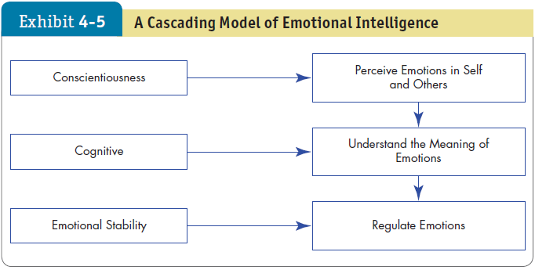

LO 5
Describe Emotional Intelligence
Notes:
Exhibit 4-5 illustrates the Cascading Model of Emotional Intelligence. Here we see the suggested relationship between Conscientiousness, Cognitive, and Emotional Stability, and the outcomes of detecting one’s own and others’ emotions, understanding what they mean, and regulating the emotions successfully.

Slide 22





Identify Strategies for Emotion Regulation
LO 6
Emotion regulation involves identifying and modifying the emotions you feel.
Emotion Regulation Influences and Outcomes
Diversity in work groups may help us to regulate our emotions more consciously and effectively.
Notes:
The process of identifying and modifying emotions you feel is called emotion regulation.
As you might suspect, not everyone is equally good at regulating emotions.
Individuals who are higher in the personality trait of neuroticism have more trouble doing so and often find their moods are beyond their ability to control.
The workplace environment has an effect on an individual’s tendency to employ emotion regulation.
In general, diversity in work groups increases the likelihood that you will regulate your emotions. Racial diversity also has an effect: if diversity is low, the minority will engage in emotion regulation, perhaps to “fit in” with the majority race as much as possible; if diversity is high and many different races are represented, the majority race will employ emotion regulation, perhaps to integrate themselves with the whole group.
These findings suggest a beneficial outcome of diversity—it may cause us to regulate our emotions more consciously and effectively.
It’s important to note that there is a downside to trying to change the way you feel. The effort involved can be exhausting.
From another perspective, research suggests that avoiding negative emotional experiences is less likely to lead to positive moods than does seeking out positive emotional experiences.

Slide 23




Identify Strategies for Emotion Regulation
LO 6
Emotion Regulation Techniques
Surface acting
Deep acting
Emotional suppression
Cognitive reappraisal
Social sharing
The best option though is to recruit positive-minded individuals and train leaders to manage their moods, attitudes, and performance.
Notes:
Researchers of emotion regulation often study the strategies people employ to change their emotions.
One technique we have discussed in this chapter is surface acting, or literally “putting on a face” of appropriate response to a given situation. Surface acting doesn’t change the emotions, though, so the regulation effect is minimal, and the result of daily surface acting leads to exhaustion and fewer OCBs.
Deep acting, another technique we have covered, is less psychologically costly than surface acting because the employee is actually trying to experience the emotion. Emotion regulation through deep acting can have a positive impact on work outcomes.
One technique of emotion regulation is emotional suppression, or suppressing initial emotional responses to situations. This response seems to facilitate practical thinking in the short term. However, it appears to be helpful only when a strongly negative event would illicit a distressed emotional reaction in a crisis situation. Thus, unless we’re truly in a crisis situation, acknowledging rather than suppressing our emotional responses to situations, and re-evaluating events after they occur, yields the best outcomes.
Cognitive reappraisal, or reframing our outlook on an emotional situation, is one way to effectively regulate emotions. This result suggests that cognitive reappraisal may allow people to change their emotional responses, even when the subject matter is highly emotionally charged.
Another technique with potential for emotion regulation is social sharing, or venting. Research shows that the open expression of emotions can help individuals to regulate their emotions, as opposed to keeping emotions “bottled up.” Social sharing can reduce anger reactions when people can talk about the facts of a bad situation, their feelings about the situation, or any positive aspects of the situation.
Note, that while emotion regulation techniques can help us cope with difficult workplace situations, research indicates that the effect varies. Thus, while there is much promise in emotion regulation techniques, the best route to a positive workplace is to recruit positive-minded individuals and train leaders to manage their moods, job attitudes, and performance.
Finally, emotion regulation has important ethical implications. Some people might argue that controlling your emotions is unethical because it requires a degree of acting. Recent research has found that acting like you are in a good mood might put you in a good mood.

Slide 24
Apply Concepts About Emotions and Moods to Specific OB Issues
LO 7
Selection
EI should be a hiring factor, especially for social jobs.
Decision Making
Positive emotions can lead to better decisions.
Creativity
Positive mood increases flexibility, openness, and creativity.
Notes:
Understanding emotions and moods can help us explain and predict selection, decision making, creativity, motivation, leadership, interpersonal conflict, negotiation, customer service, job attitudes, and deviant workplace behaviors. When it comes to selection, EI should be a hiring factor to ensure employee fit. Positive emotions can lead to better decisions and often more creative ones as well.

Slide 25

Apply Concepts About Emotions and Moods to Specific OB Issues
LO 7
Motivation
Positive mood affects expectations of success.
Feedback amplifies this effect.
Leadership
Emotions are important to acceptance of messages from organizational leaders.
Negotiation
Emotions can affect negotiations.
Notes:
Positive mood affects expectations of success by all people, which contributes to their motivation for performance. Leadership is affected by mood and emotion, as people in a positive emotional state are found to be more receptive of messages from leaders. Emotions, those both held and displayed, are effective contributors to negotiation, as the potential impact of displayed emotion on negotiation is large. The best negotiators are probably those who remain emotionally detached.

Slide 26
Apply Concepts About Emotions and Moods to Specific OB Issues
LO 7
Customer Service
Emotions influence customer service.
Influences repeat business and customer
satisfaction.
Emotional contagion: “catching” emotions.
Job Attitudes
A good day at work tends to be followed by
a good mood at home and vice versa.
This usually dissipates overnight.
Notes:
Emotions affect customer service in a number of ways, ranging from the attitude of the employee, to the effectiveness of communication with customers, to overall feelings about the outcome. Research has found that people who are on an emotional high at the end of a day take the positive feelings home with them, and vice versa. This good mood, however, tends to dissipate overnight.

Slide 27


Apply Concepts About Emotions and Moods to Specific OB Issues
LO 7
Deviant Workplace Behaviors
Negative emotions lead to workplace
deviant behaviors.
Actions that violate norms and threaten
the organization.
Safety and Injury at Work
Don’t do dangerous work when in a bad
mood.
Notes:
Negative emotions can lead to deviant workplace behaviors. These are actions that violate norms and threaten the organization.
Once aggression starts, it’s likely that other people will become angry and aggressive, so the stage is set for a serious escalation of negative behavior.
Managers, therefore, need to stay connected with their employees to gauge emotions and emotional intensity levels.
In addition, research has found that workers asked to do dangerous work while in negative emotional states are more likely to have accidents. Selecting positive team members can have a contagion effect, as positive moods transmit from team member to team member.

Slide 28
Implications for Managers
Recognize that emotions are a natural part of the workplace and good management does not mean creating an emotion-free environment.
To foster effective decision making, creativity, and motivation in employees, look to model positive emotions and moods as much as is authentically possible.
Provide positive feedback to increase the positivity of employees. Of course, it also helps to hire people who are predisposed to positive moods.
Notes:
Finally,
Recognize that emotions are a natural part of the workplace and good management does not mean creating an emotion-free environment.
To foster effective decision making, creativity, and motivation in employees, look to model positive emotions and moods as much as is authentically possible.
Provide positive feedback to increase the positivity of employees. Of course, it also helps to hire people who are predisposed to positive moods.

Slide 29
Implications for Managers
In the service sector, encourage positive displays of emotion, which make customers feel more positive and thus, improve customer service interactions and negotiations.
Understand the role of emotions and moods to significantly improve your ability to explain and predict your coworkers’ and other’s behavior.
Notes:
Finally,
In the service sector, encourage positive displays of emotion, which make customers feel more positive and thus, improve customer service interactions and negotiations.
Understand the role of emotions and moods to significantly improve your ability to explain and predict your coworkers’ and other’s behavior.
As one consultant aptly put it, “You can’t divorce emotions from the workplace because you can’t divorce emotions from people.” Managers who understand the role of emotions and moods will significantly improve their ability to explain and predict their coworkers’ and employees’ behavior.

